Slide 1
The Three R’s of Computer Vision: Recognition, Reconstruction & Reorganization
Jitendra Malik
UC Berkeley

Slide 2
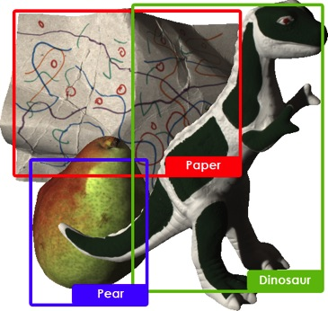

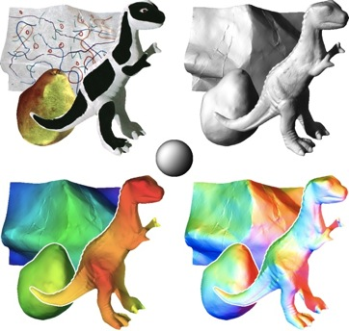
Recognition, Reconstruction & Reorganization
Recognition
Reorganization
Reconstruction

Slide 3
The Three R’s of Vision
Recognition
Reconstruction
Reorganization
Each of the 6 directed arcs in this diagram is a useful direction of information flow

Slide 4
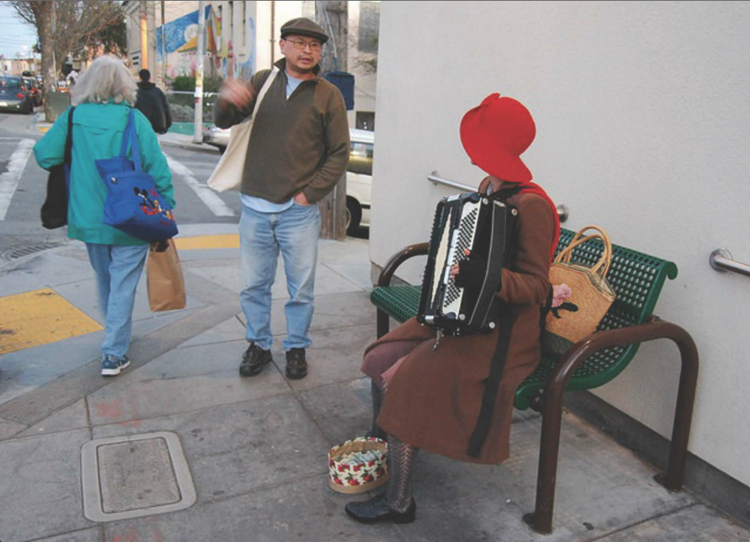

Slide 5
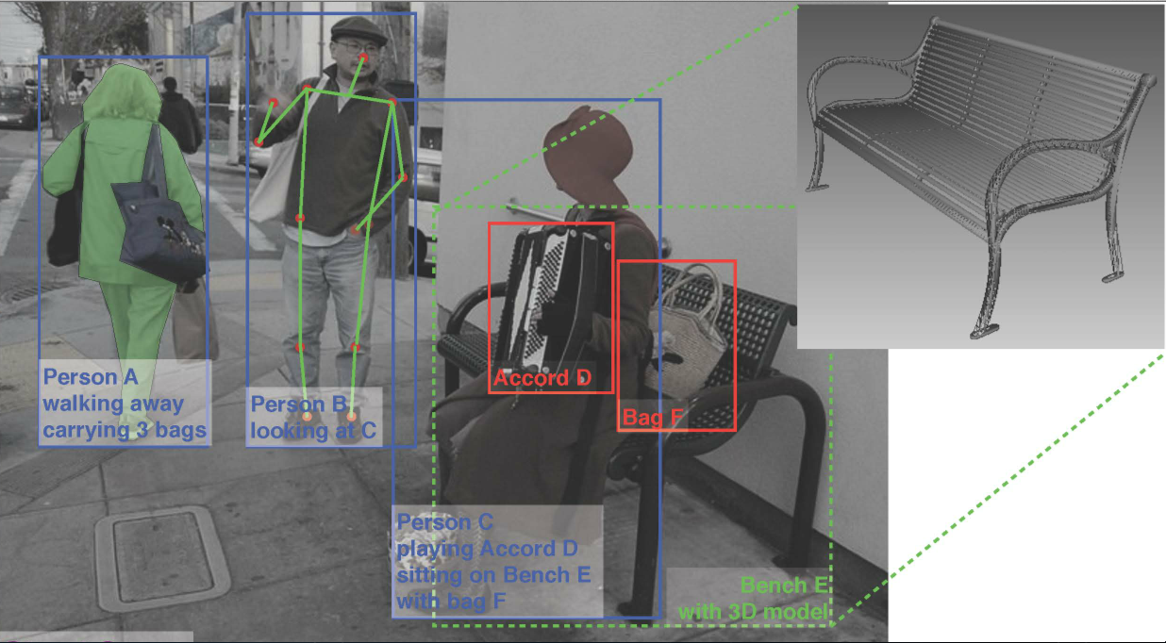
What we would like to infer…
Will person B put some money into Person C’s tip bag?

Slide 6
Different aspects of vision
Perception: study the “laws of seeing” -predict what a human would perceive in an image.
Neuroscience: understand the mechanisms in the retina and the brain
Function: how laws of optics, and the statistics of the world we live in, make certain interpretations of an image more likely to be valid
The match between human and computer vision is strongest at the
level of function, but since typically the results of computer vision are
meant to be conveyed to humans makes it useful to be consistent
with human perception. Neuroscience is a source of ideas but being
bio-mimetic is not a requirement.

Slide 7
Facts about the Visual World
The world consists of rigid, or piecewise rigid, objects
Object surfaces have piecewise constant color and texture
Objects in a category share parts
Projection from the 3D world to 2D image is uniquely defined
Objects are opaque & nearer objects occlude farther objects.
Objects occur at varying distances and locations in the image
Objects occur in context, stereotypical relations to each other
Actions are performed by agents with goals and intentions
….
We can incorporate these into the design of visual
processing architectures. Parameters should be learnt.

Slide 8
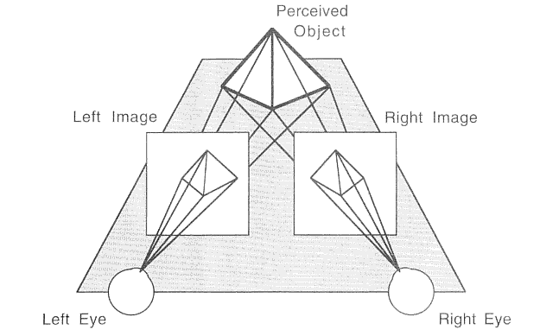
Binocular Stereopsis

Slide 9
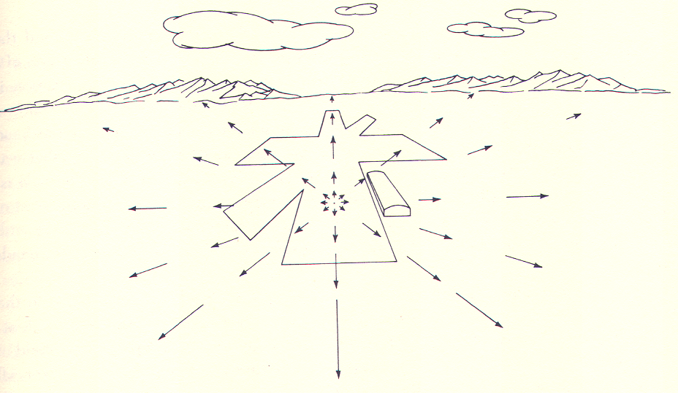
Optical flow is a basic cue for all animals

Slide 10
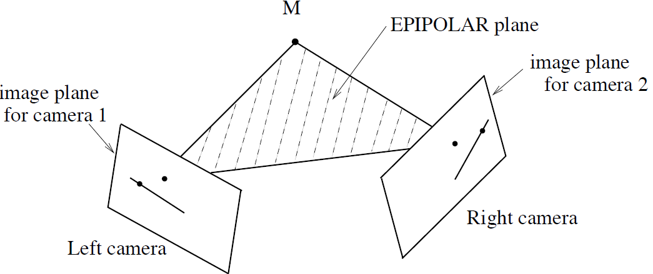
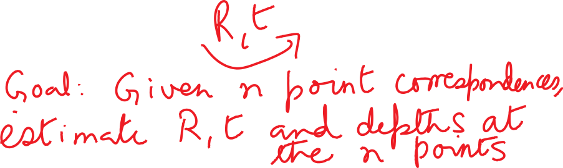
Epipolar geometry for cameras in general position

Slide 11
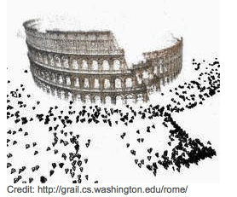
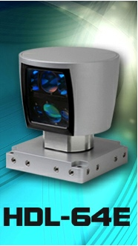
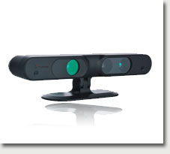
State of the Art in Reconstruction
Multiple photographs
Range Sensors
Kinect (PrimeSense)
Velodyne Lidar
Agarwal et al (2010)
Frahm et al, (2010)
Semantic Segmentation is needed to make this more useful…

Slide 12
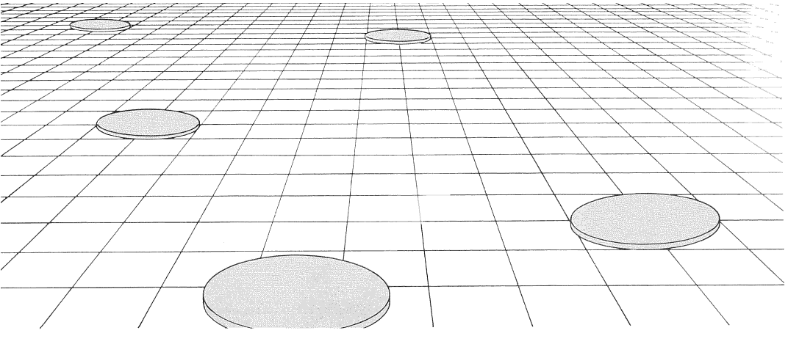
Some Pictorial Cues
Notes:
Here if we assume that the slabs are all of the same size and shape in the scene, then the apparent diminution of size on the image plane is a cue to changes in depth and surface slant. These kinds of grids are ubiquitous in Renaissance paintings.

Slide 13
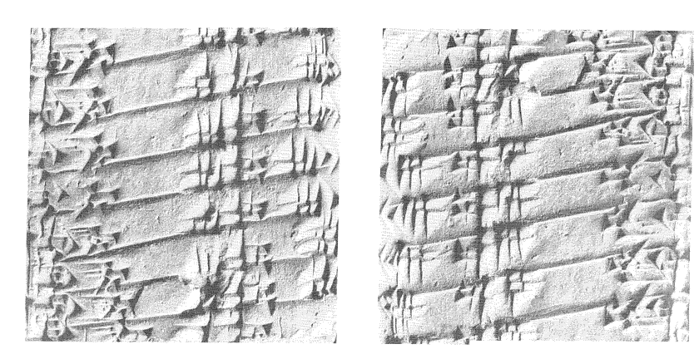
Shading
Notes:
The two halves of the figure correspond to exactly the same image, except that one has been rotated by 180 degrees. This changes our perception of ridges into grooves and vice versa. Humans make the assumption that the light comes from above.

Slide 14
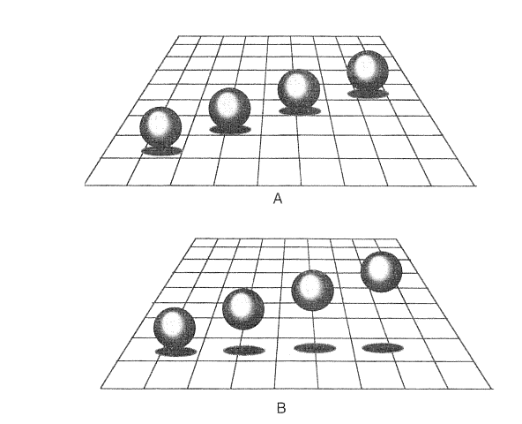
Cast Shadows
Notes:
By suitable manipulation of the position of the cast shadow, we can change the perception of whether the spheres are resting on the ground plane or not. This changes our perception of their depths. After Kersten and Knill.

Slide 15
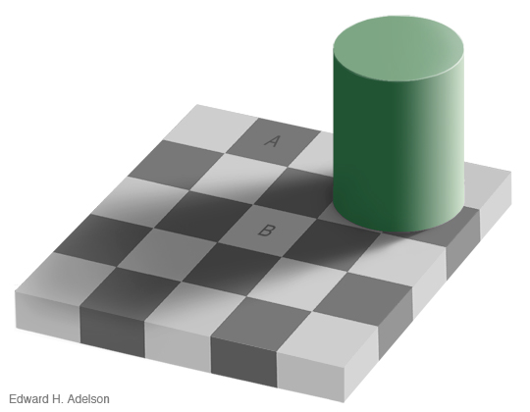

Slide 16
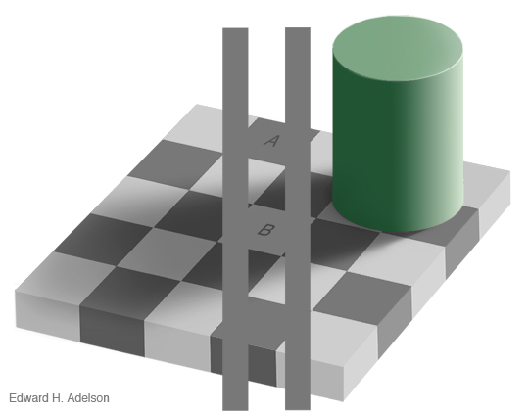

Slide 17
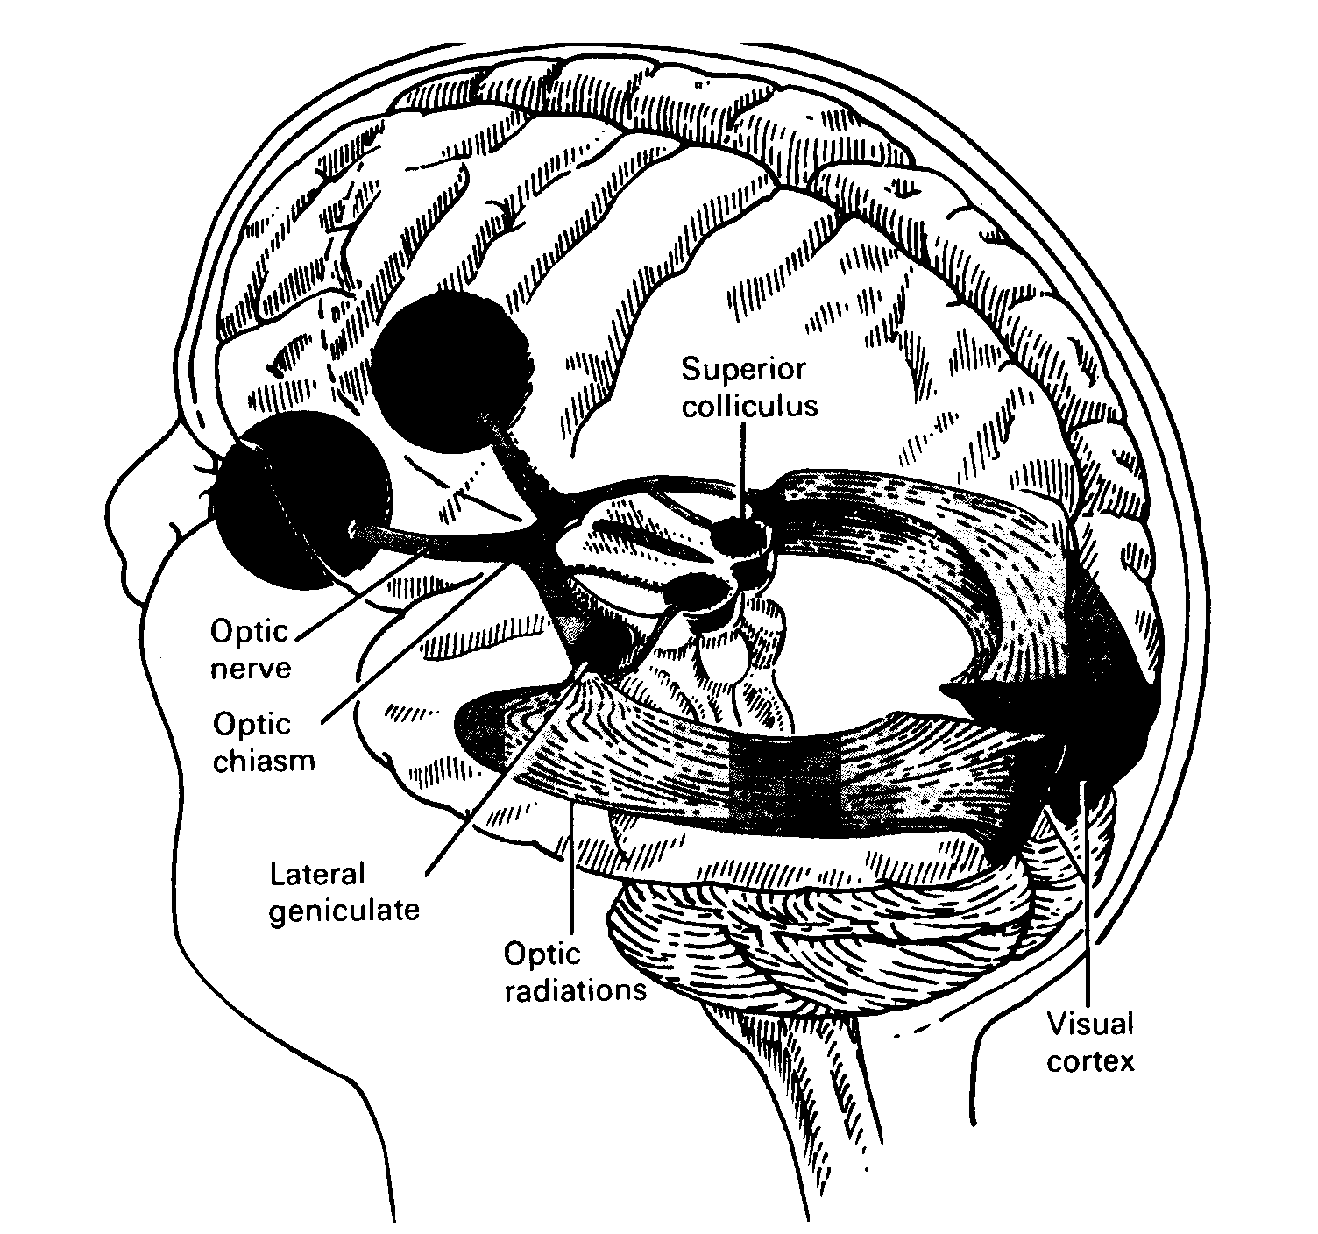
The Visual Pathway

Slide 18
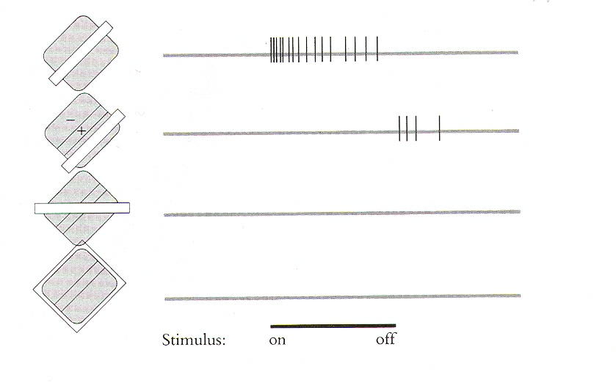
Hubel and Wiesel (1962) discovered orientation sensitive neurons in V1

Slide 19
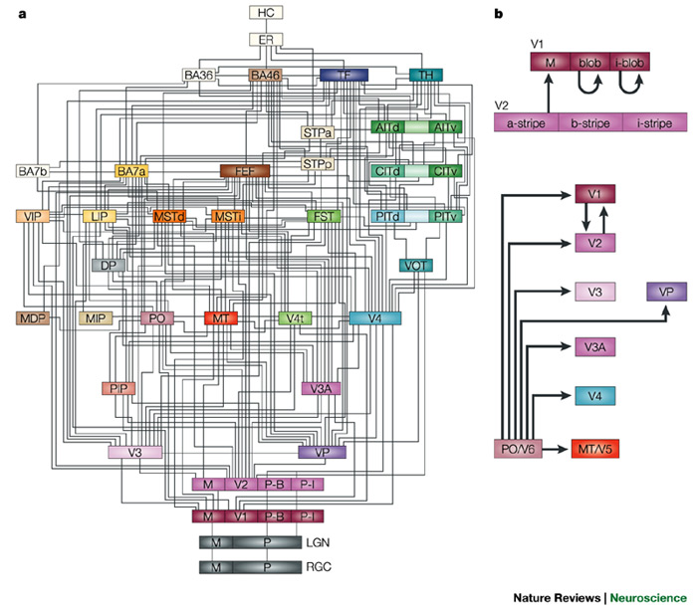
Block Diagram of the Primate Visual System
D. Van Essen Lab

Slide 20
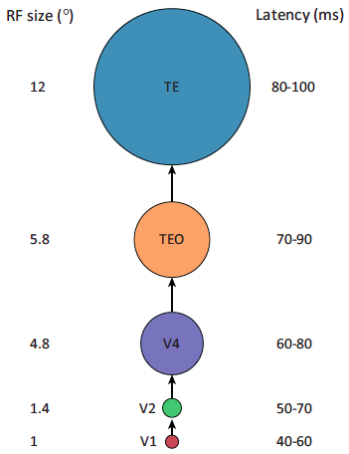
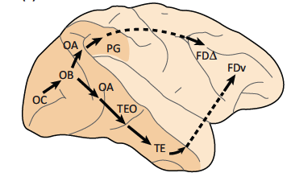
Feed-forward model of the ventral stream
Kravitz et al, Trends in Cognitive Science 2013

Slide 21
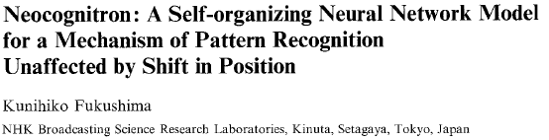
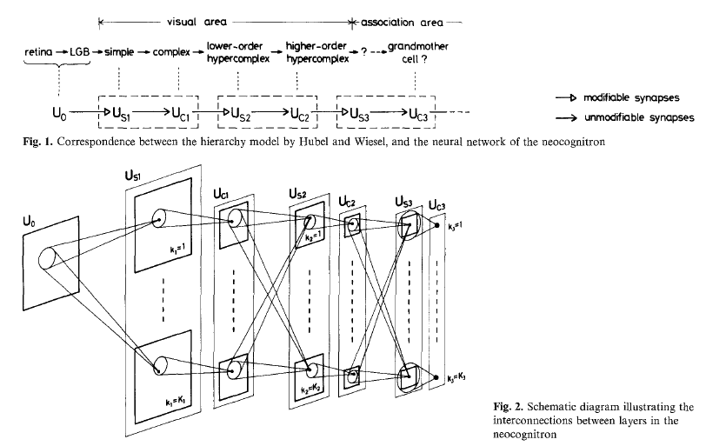

Slide 22
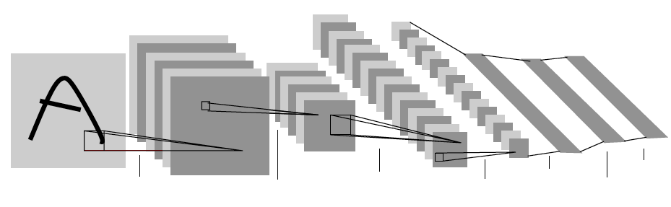
Convolutional Neural Networks (LeCun et al ) Used backpropagation to train the weights in this architecture
First demonstrated by LeCun et al for handwritten digit recognition(1989)
Krizhevsky, Sutskever & Hinton showed effectiveness for full image classification on ImageNet Challenge (2012)
Girshick, Donahue, Darrell & Malik (arxiv, 2013)(CVPR 2014) showed that these features were also effective for object detection
And many others…

Slide 23
The Three R’s of Vision
Recognition
Reconstruction
Reorganization
Each of the 6 directed arcs in this diagram is a useful direction of information flow

Slide 24
The Three R’s of Vision
Recognition
Superpixel assemblies as candidates
Reconstruction
Reorganization

Slide 25
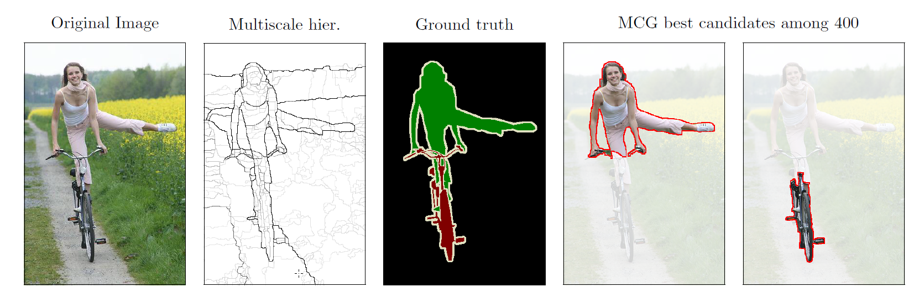
Bottom-up grouping as input to recognition
We produce superpixels of coherent color and texture first,
then combine neighboring ones to generate object candidates

Slide 26
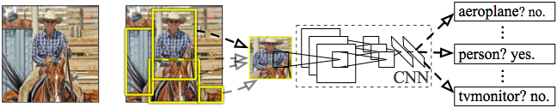
R-CNN: Regions with CNN features Girshick, Donahue, Darrell & Malik (CVPR 2014)
Input
image
Extract region
proposals (~2k / image)
Compute CNN
features
Classify regions
(linear SVM)
CNN features are inspired by the
architecture of the visual system

Slide 27
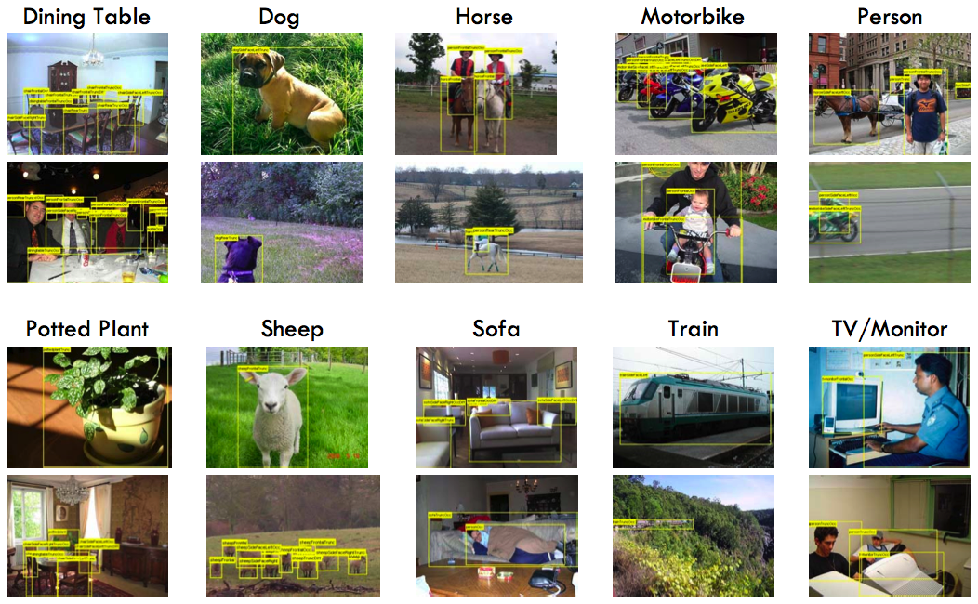
PASCAL Visual Object Challenge
(Everingham et al)

Slide 28
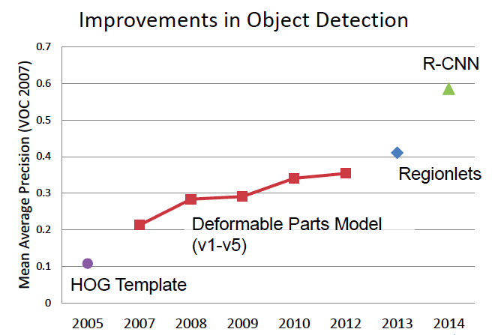
State of the Art in Recognition
(Slide from D. Hoiem)

Slide 29
How about the other direction…
Recognition
Reconstruction
Reorganization

Slide 30
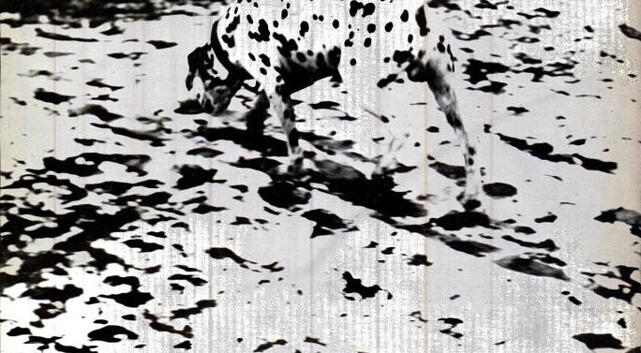
Recognition Helps Reorganization

Slide 31
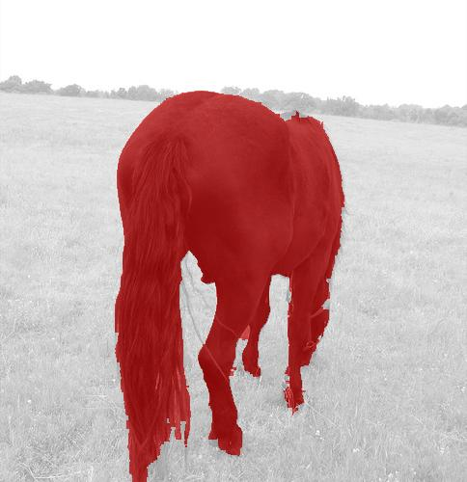
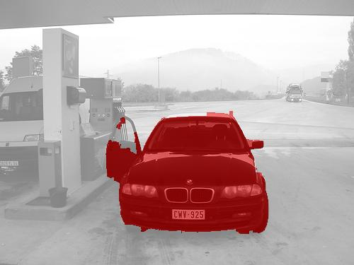
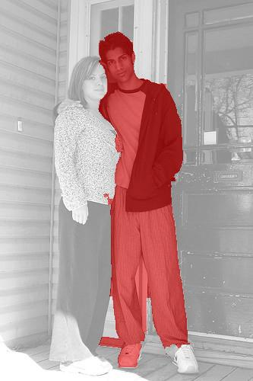
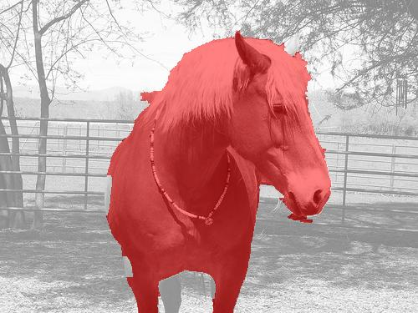
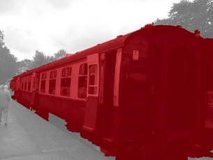
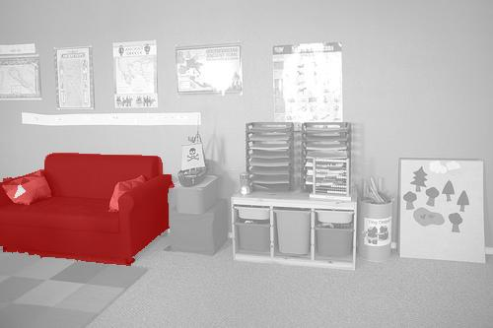
Results of Simultaneous Detection and Segmentation Hariharan, Arbelaez, Girshick & Malik (2014)
We mark the pixels corresponding to an
object instance, not just its bounding box.

Slide 32
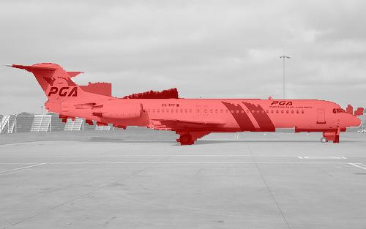
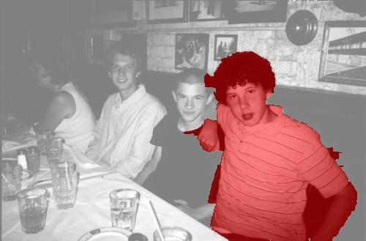
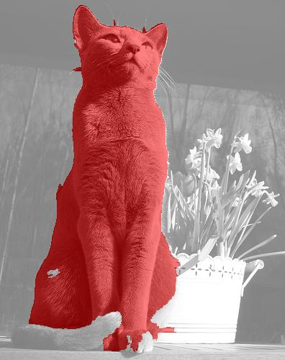
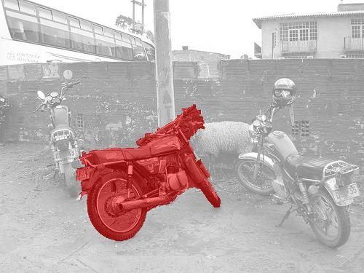
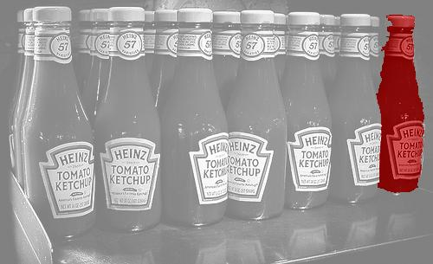
More results

Slide 33
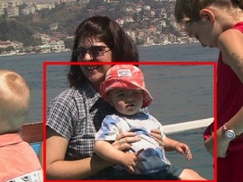
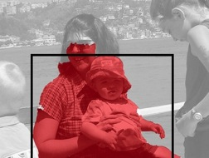

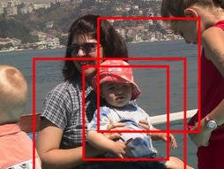
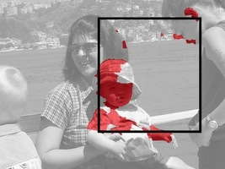
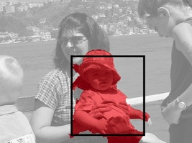
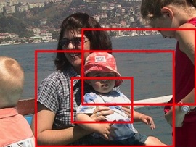

We train classifiers to predict top-down the pixels belonging to the object
Score
Original detection
Search nearby
Segment
Score
Regress boxes
Score

Slide 34
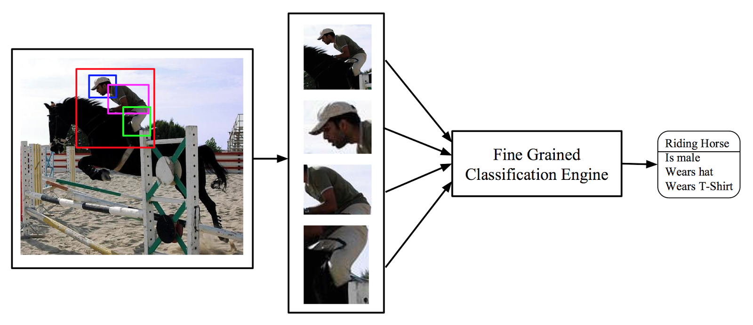
Actions and Attributes from Wholes and Parts G. Gkioxari, R. Girshick & J. Malik

Slide 35
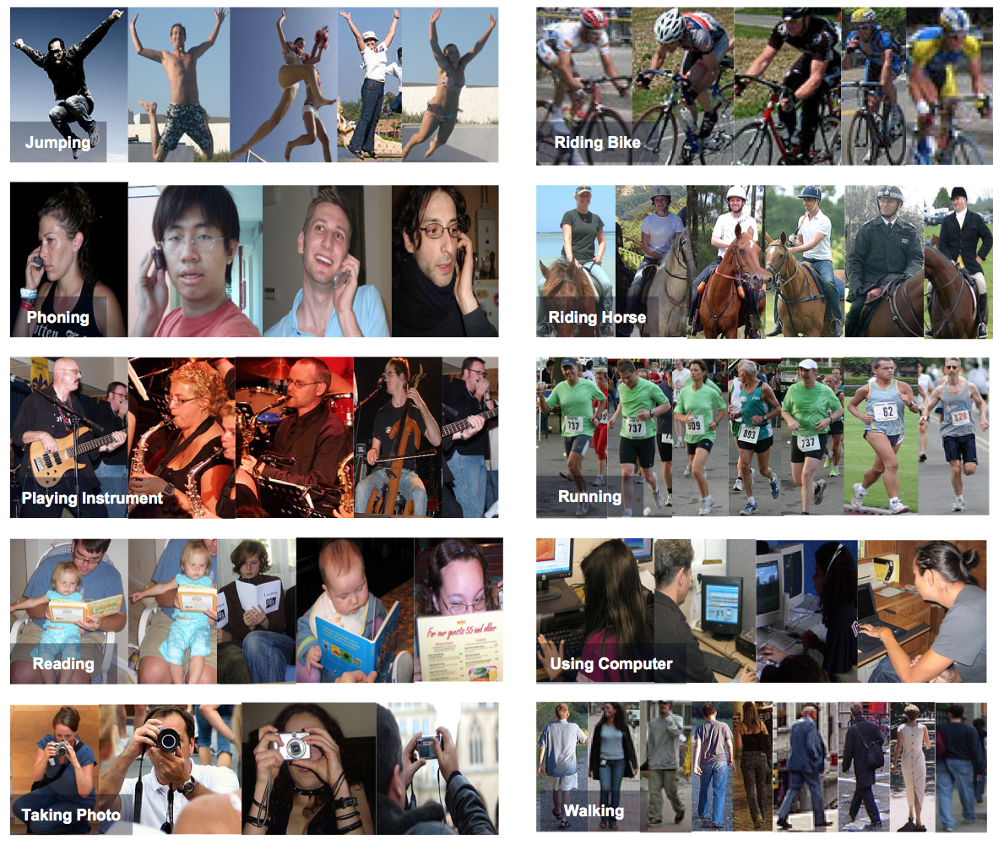

Slide 36
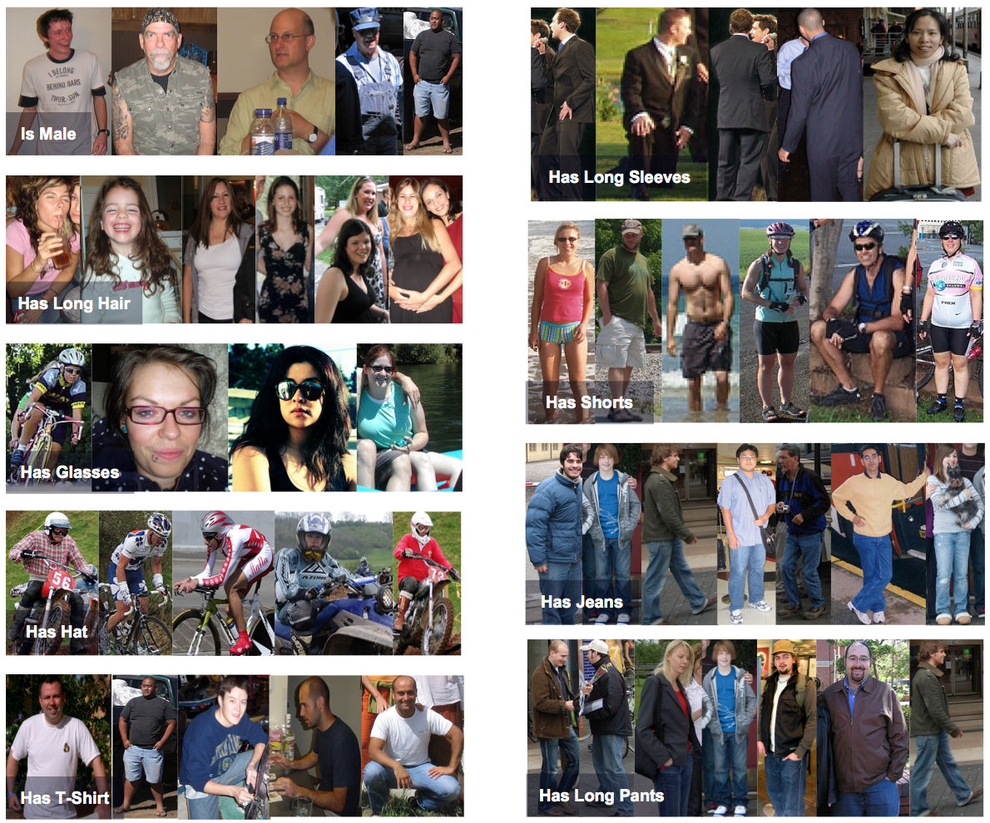

Slide 37
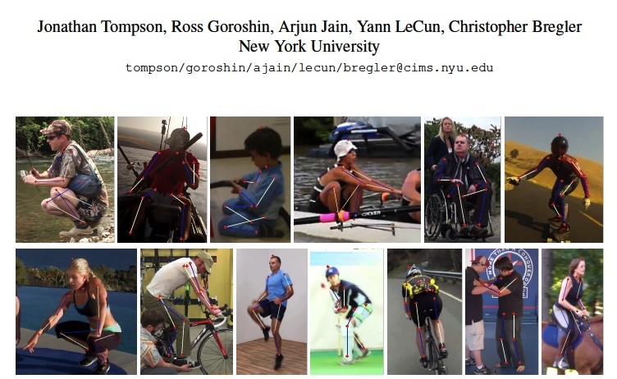
Finding Human Body Joints

Slide 38

Viewpoint Prediction for Objects Tulsiani & Malik (2014)
The columns show 15th, 30th, 45th, 60th, 75th and 90th percentile instances respectively
in terms of the error.

Slide 39

Keypoint Prediction for Objects
Visualization of keypoints predicted in the detection setting. We sort the keypoints detections by their prediction score and visualize every 15th detection for ’Nosetip’ of aeroplanes, ’Left Headlight’ of cars and ’Crankcentre’ of bicycles.

Slide 40
The Three R’s of Vision
Recognition
Reconstruction
Reorganization
We have explored category-specific 3D reconstruction.

Slide 41

Category Specific Object Reconstruction
Kar, Tulisiani, Carreira & Malik
Notes:
Overview figure; Instance segmentation using SDS, Viewpoint estimation using Shubham’s CNN → 3D reconstruction and SIRFS refinement

Slide 42

Deformable 3D Model Learning
Viewpoint estimation – NRSfM on keypoint correspondences
Idea - Deform a mesh to satisfy silhouettes from different viewpoints
Energies - Consistency, Coverage, Smoothness, Keypoint
Intra-class Variation - Linear deformation modes
Notes:
All energies are terms in the optimization. Consistency and coverage ensure that the silhouettes are obeyed, smoothness ensures a smooth shape (in both normals space) and keypoint constraints are also to be obeyed.

Slide 43

Basis Shape Models
Notes:
Mean shapes learnt for different classes

Slide 44


Results

Slide 45
The Three R’s of Vision
Recognition
Reconstruction
Reorganization
These ideas apply equally well in a video setting

Slide 46




Images
Video
Image classification
“Is there a dog in the image?”
Object detection
“Is there a dog and where is it in the image?”
Action classification
“Is there a person diving in the video?”
Action detection
“Is there a person diving and where is it in the video?”

Slide 47

Results on UCF Sports (Gkioxari & Malik, 2014)
Tracking error
Action prediction error

Slide 48

Results on J-HMDB

Slide 49
The Three R’s of Vision
Recognition
Reconstruction
Reorganization

Slide 50



Scene Understanding using RGB-D data Gupta, Girshick, Arbelaez, Malik (ECCV 2014)
Color and Depth
Image Pair
Complete 3D Understanding

Slide 51







Overview
Input
Re-organization
Recognition
Detailed 3D Understanding
Contour Detection
Semantic Segm.
Color and Depth
Image Pair
Instance Segm.
Object Detection
Region Proposal
Generation
Pose Estimation

Slide 52






























Instance Segmentation

Slide 53


Slide 54
I hope you enjoy the course!

